Slide 1
JAVASCRIPT DOM

Slide 2
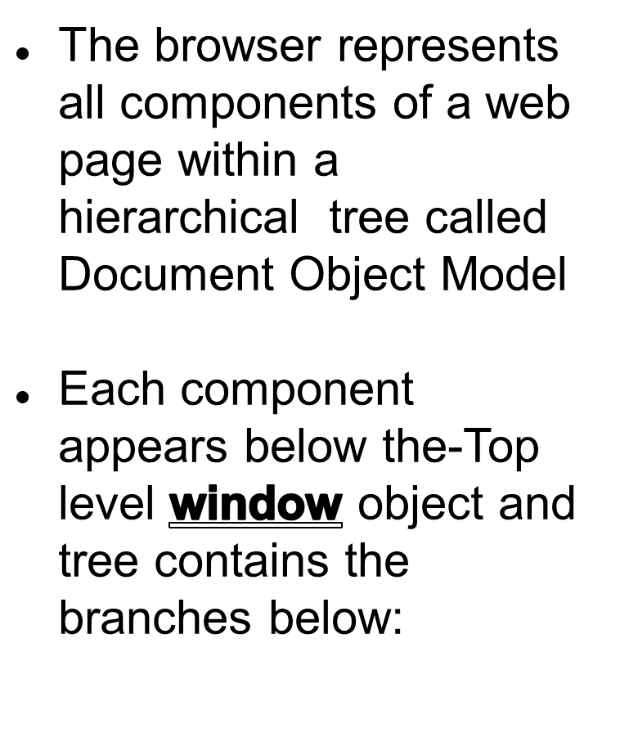
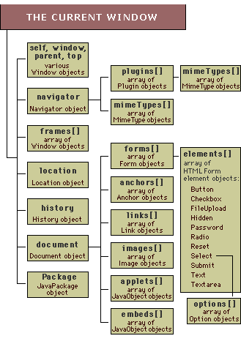
Introduction to DOM

Slide 3
Browser Management

Slide 4
//Program to display all properties of the window
<script>
function display()
{
var property;
var panel=document.getElementById(“panel”);
for(property in window)
{
if(property)
{
panel.innerHTML+=property+" ";
}
}
}
</script>
<div id=“panel”>
<form>
<button onclick="display()">Generate</button></form>
</div>
</form>

Slide 5
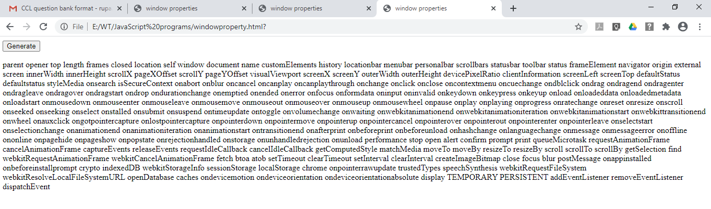

Slide 6
Inspecting window properties
Window properties are:
Overall screen dimensions can be found in properties:
screen.width and screen.height
Screen color capability in bit value form can be found using
  screen.colorDepth
  Displaying status message in window status bar
  window.defaultStatus

Slide 7
Ex:
<script>
function init()
{
var panel=document.getElementById("panel");
var width,height,avwidth,avheight,colors;
width=window.screen.width;
height=window.screen.height;
avwidth=window.screen.availWidth;
avheight=window.screen.availHeight;
switch(window.screen.colorDepth)
{
case 8: colors="Low color" ;break;
case 16:colors="High color"; break;
case 24:colors="24 colors";break;
case 32: colors="True color"; break;}
panel.innerHTML="Width"+width+"x"+height+"<br/>avialable screen size"+avwidth+"x"+avheight+"<br/>color capability"+colors;
}
window.onload=init;

Slide 8
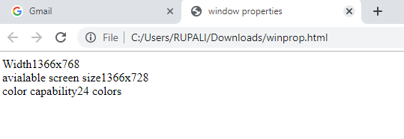

Slide 9
Displaying dialog message
There are three dialog messages
1) alert()
2) prompt()
3) confirm()

Slide 10
Opening and closing window
A new browser window can be opened and closed using
1) Window.open()
2) windowobject.close();
Open() method syntax:
window.open=(“name/path of new window”,
”name of window”,
”top=val,left=val,width=val,height=val,status=yes/no”);
Close() method syntax:
winobject.close();

Slide 11
function init()
{
var panel=document.getElementById("panel");
panel.innerHTML="Regular information to be displayed in main window";
var winobj=
window.open(“winprop.html","mynewpopup","top=200,left=100,width=400,height=100,status=yes");
winobj.close();
}
window.onload=init;

Slide 12
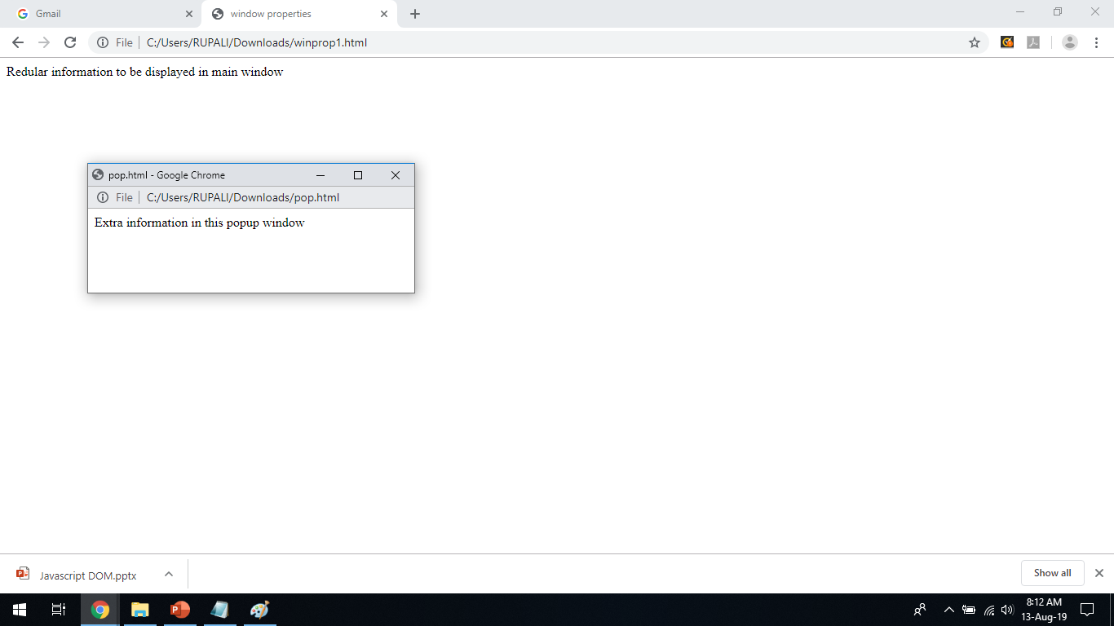

Slide 13
Scrolling and moving position
DOM window object allows the window to be scrolled horizontally and vertically when window overflows in either orientation.
Methods:
  1) scrollby(x,y)
  2) scrollto(x,y)
  3) moveto(x,y)
  4) moveby(x,y)

Slide 14
<html>
<body>
<button onclick="openWin()">Create new window</button>
<button onclick="moveWinTo()">Move new window</button>
<button onclick="moveWinBy()">Move the new window by 75 * 50px</button>
<script>
var myWindow;
function openWin() {
myWindow = window.open("", "", "width=250, height=250");}
function moveWinTo() {
myWindow.moveTo(150, 150); myWindow.focus();}
function moveWinBy()
{ myWindow.moveBy(75, 50); myWindow.focus();}
</script>
</body>
</html>

Slide 15
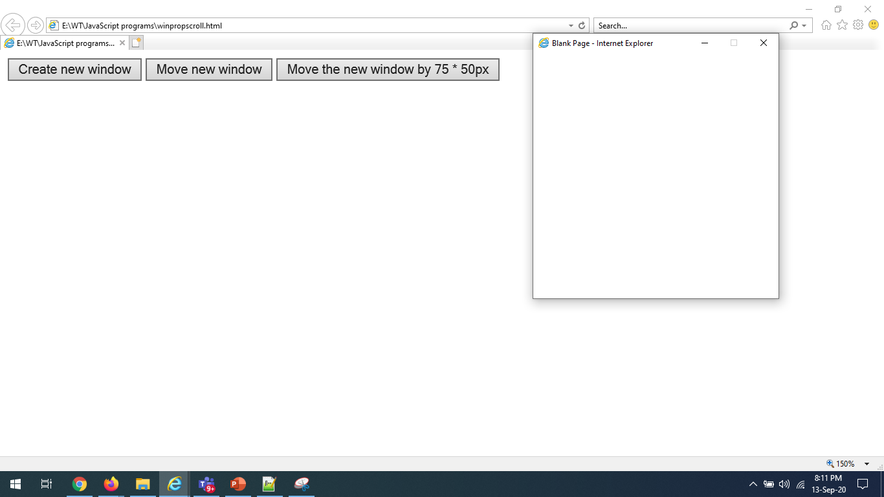
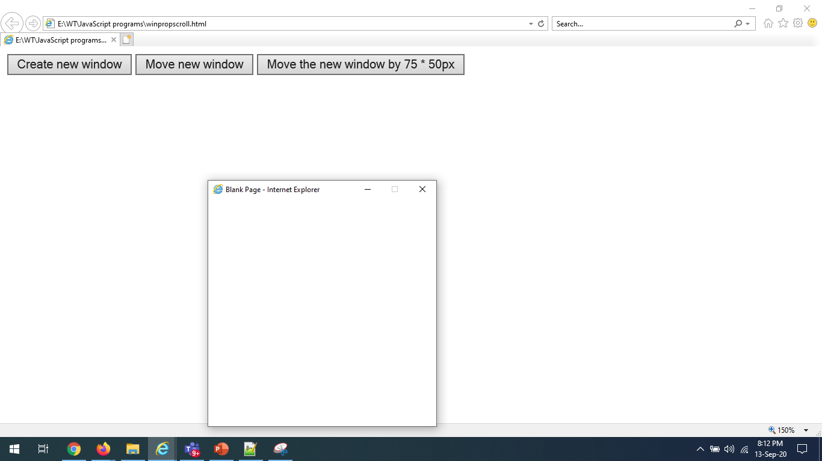
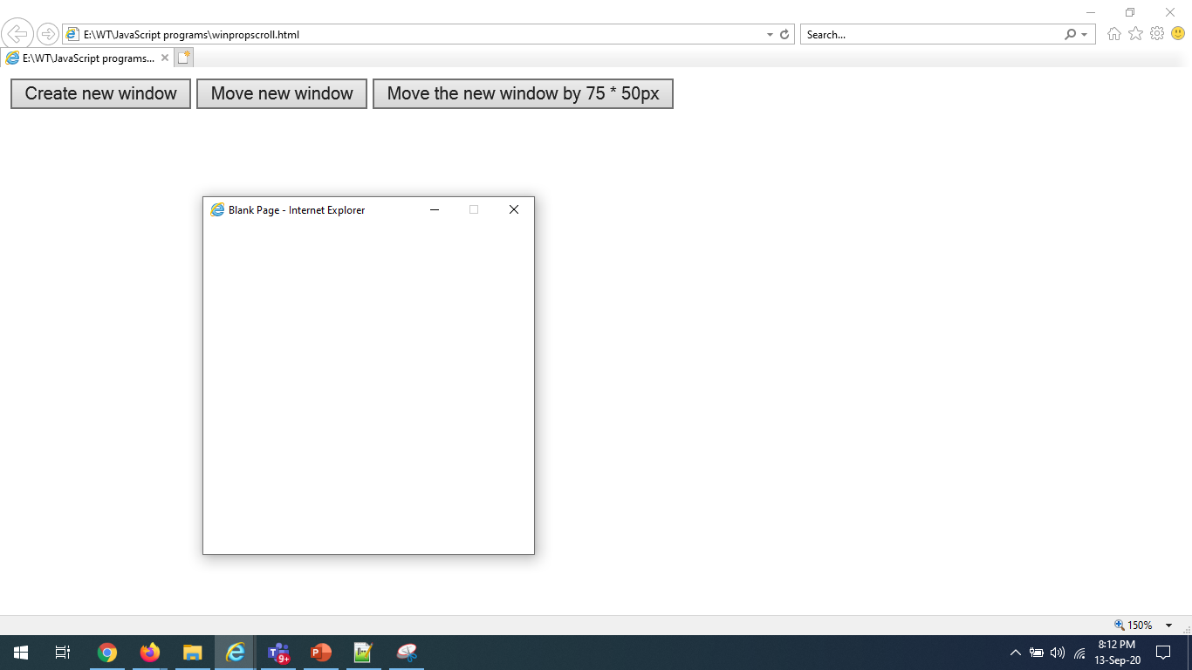
Scrolling and moving position

Slide 16
<script>
function init()
{
var panel=document.getElementById("panel");
for(i=1;i<2001;i++)
{
panel.innerHTML+=i+” “;
}
window.scrollby(0,500);
window.moveto(0,0);
}
window.onload=init;

Slide 17
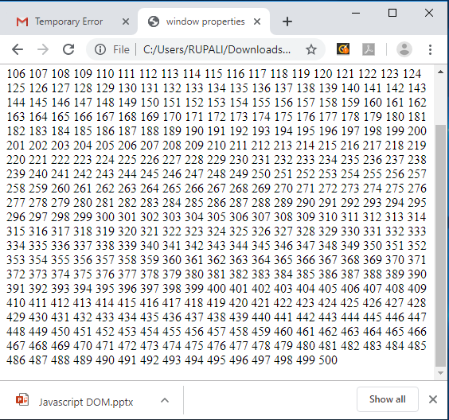
Scrolling and moving position

Slide 18
Window timer
Javascript window object has timer methods
Methods are:
1) setTimeout()
2) clearTimeout()
3) setInterval()
4)clearInterval()

Slide 19
else
{
count=0;
as();
}
}
</script>
<script language=javascript>
var count=0;
function as()
{
setTimeout("fun1()",5000);
}
function fun1()
{
var a =new
Array("red","darkblue","sky","yellow","blue","pink","green");
if(count<=6)
{
document.bgColor=a[count++];
setTimeout("fun1()",5000);
}

Slide 20
var counter=0; //global variable
function init()
{
var timerid,panel=document.getElementById("panel");
counter++;
panel.innerHTML+=counter+" ";
if(counter>19)
{
window.clearTimeout(timerid);
}
else
{ timerid=window.setTimeout(init,1000); }
}
window.onload=init;

Slide 21
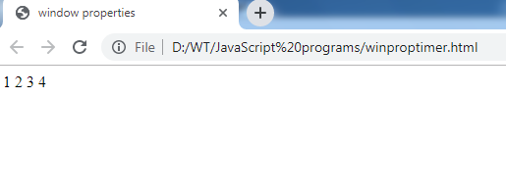
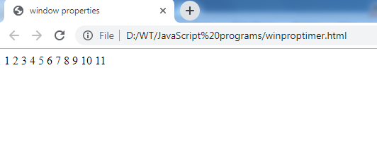
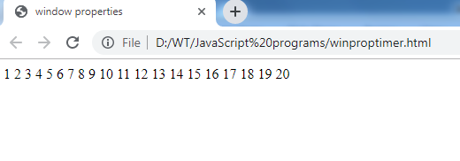

Slide 22
<html>
<body>
<p>A script on this page starts this clock:</p>
<p id="demo"></p>
<button onclick="myStopFunction()">Stop time</button>
<script>
var myVar = setInterval(myTimer, 1000);
function myTimer() {
var d = new Date();
var t = d.toLocaleTimeString();
document.getElementById("demo").innerHTML = t;
}
function myStopFunction() {
clearInterval(myVar);
}
</script>
</body>
</html>

Slide 23
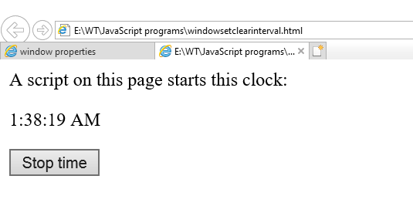
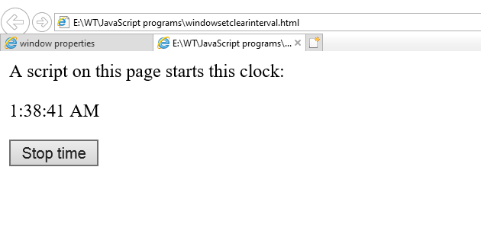

Slide 24
Controlling window location
Window’s location object is used to give information as:
  Full URL of document
  Protocol
  Host
  Pathname
  Fragment anchor with #

Slide 25
Ex:
<script>
function init()
{
var panel=document.getElementById("panel");
var jump=confirm("Jump to fragment");
if (jump)
window.location=window.location.href+"#frag";
panel.innerHTML+="<br/>Href:"+window.location.href;
panel.innerHTML+="<br/>Protocol:"+window.location.protocol;
panel.innerHTML+="<br/>Host:"+window.location.host;
panel.innerHTML+="<br/>Path:"+window.location.pathname;
panel.innerHTML+="<br/>Hash:"+window.location.hash;
}
window.onload=init;
NOTE:Run it on Server

Slide 26
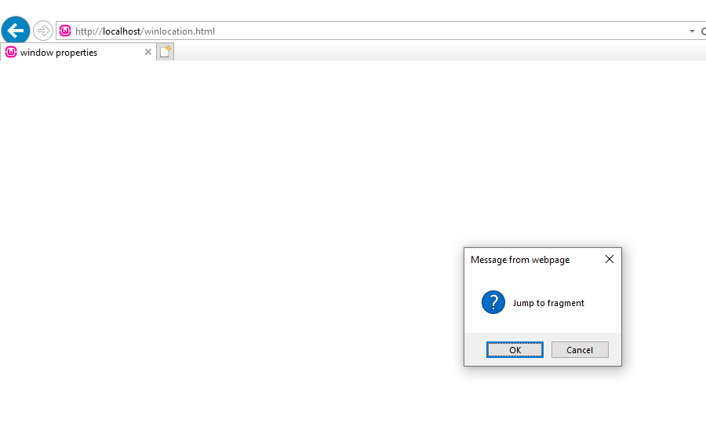
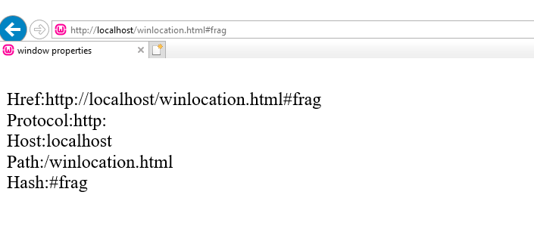

Slide 27
Navigator object
window.navigator object contains information about web browser.
Navigator object has following properties:
1)appName
2)appCodeName
3)appVersion
4)platform

Slide 28
Navigator object –to query browser
<script>
function init()
{
var panel=document.getElementById("panel");
panel.innerHTML+="<br/>Browser:"+navigator.appName;
panel.innerHTML+="<br/>Codename:"+navigator.appCodeName;
panel.innerHTML+="<br/>Version"+navigator.appVersion;
panel.innerHTML+="<br/>Platform:"+navigator.platform;
}
window.onload=init;

Slide 29
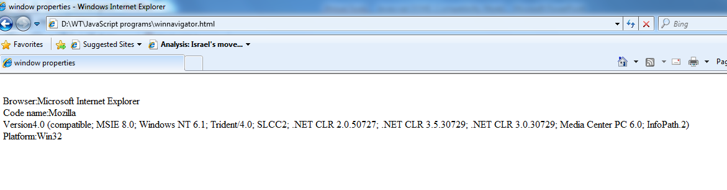

Slide 30
Navigator object and its child object
Navigator child objects are:
1)plugins
2)mimeTypes (Multipurpose Internet Mail Exchange)
plugins array element has name and description and
mimetypes array element has type and description property

Slide 31
function init()
{
var panel=document.getElementById("panel");
if(navigator.javaEnabled())
{panel.innerHTML="Java support is enabled";
}
if(navigator.plugins.length!=0)
{
panel.innerHTML+="<hr>Totalplugins:"+navigator.plugins.length;
panel.innerHTML+="<br/>Exmaple:"+navigator.plugins[1].name;
panel.innerHTML+="--"+navigator.plugins[1].description;
}
if(navigator.mimeTypes.length!=0)
{
panel.innerHTML+="<hr>Total MIMEtypes:"+navigator.mimeTypes.length;
panel.innerHTML+="<br/>Exmaple:"+navigator.mimeTypes[1].name;
panel.innerHTML+="--"+navigator.mimeTypes[1].description; }
} window.onload=init;

Slide 32
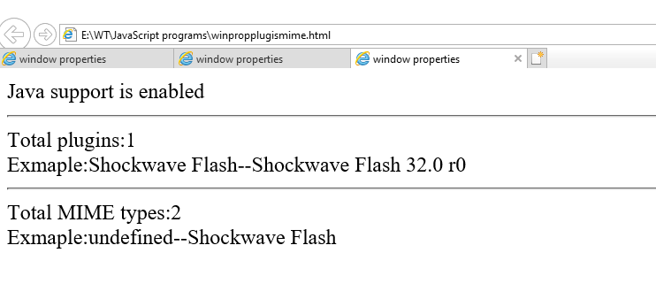

Slide 33
Extracting Document Info
Window object’s children is document object,which provides access to the HTML document.
Properties of document object are:
1) document.title
2) document.referrer(URL of web page with hyperlink)
3) document.URL(location of HTML document)
4) document.domain
5) document.lastModified

Slide 34
<script>
function init()
{
var panel=document.getElementById("panel");
panel.innerHTML+="Linked from"+document.referrer;
panel.innerHTML+="<br/>Title:"+document.title;
panel.innerHTML+="<br/>URL:"+document.URL;
panel.innerHTML+="<br/>Domain:"+document.domain;
panel.innerHTML+="<br/>Lastmodified"+document.lastModified;
}
window.onload=init;
NOTE:Run it on Server

Slide 35
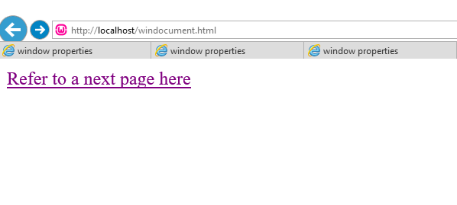
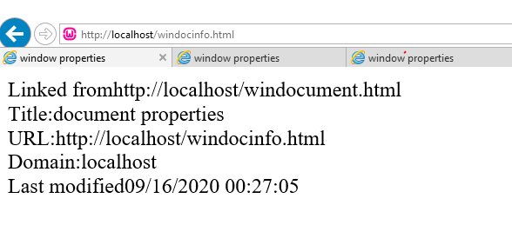

Slide 36
Addressing Component arrays
DOM document object has child objects as,
  forms,anchors,images links.
  Syntax:
  document.childobjectname.length;
  document.childobjectname[index].src;
  Ex:
  panel.innerHTML+=“ “+document.forms.length;
  panel.innerHTML+=“ “+document.links.length;
  panel.innerHTML+=“ “+document.images[0].src;
  Each of these children is an array in which every array element represents a document component in same order they appear within HTML document

Slide 37
EVENT Handling in JAVASCRIPT

Slide 38
addEventlistener in javascript
The addEventListener() is an inbuilt function .
Syntax:
element.addEventListener(event , listener);
Parameters:
event : event can be any valid JavaScript event.
Events are used without “on” prefix like use “click” instead of “onclick” or “mousedown” instead of “onmousedown”.
listener(handler function) :
It can be a JavaScript function which respond to the event occur.
Any number of event handlers can be added to a single element without overwriting existing event handlers.

Slide 39
<body>
<button id="clickIt">Click here</button>
<p id="hoverPara">Hover over this Text !</p>
<b id="effect"></b>
<script>
const x = document.getElementById("clickIt");
const y = document.getElementById("hoverPara");
x.addEventListener("click", RespondClick);
y.addEventListener("mouseover", RespondMouseOver);
y.addEventListener("mouseout", RespondMouseOut);
function RespondMouseOver() { document.getElementById("effect").innerHTML +=
"MouseOver Event" + "<br>"; }
function RespondMouseOut() {
document.getElementById("effect").innerHTML +=
"MouseOut Event" + "<br> }
function RespondClick() {
document.getElementById("effect").innerHTML +=
"Click Event" + "<br>"; }
</script> </body>

Slide 40
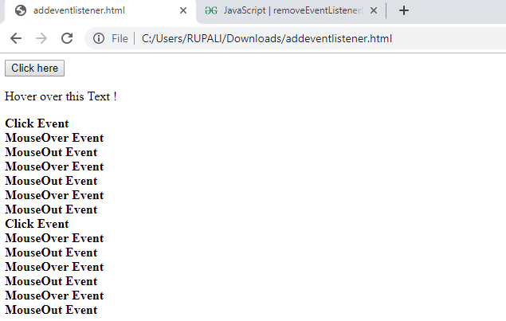

Slide 41
removeEventListener in javascript
The removeEventListener() is an inbuilt function in JavaScript which removes an event handler from an element for a attached event.
For example, if a button is disabled after one click you can use
removeEventListener() to remove a click event listener.
Syntax:
element.removeEventListener(event, listener, useCapture);

Slide 42
removeEventListener in javascript
Parameters: It accepts three parameters which are specified below-
event: It is a string which describes the name of event that has to be remove.
listener: It is the function of the event handler to remove.
useCapture: It is an optional parameter.
By default it is Boolean value false which specifies the removal of event handler from the bubbling phase and if it is true than the removeEventListener() method removes the event handler from the capturing phase.

Slide 43
<html>
<body>
<h3>Click this button to stop hovering effect !!</h3>
<button id="clickIt" onclick="RespondClick()">Click here</button>
<h1 id="hoverPara">Hover over this Text !</h1>
<b id="effect"></b>
<script>
const y = document.getElementById("hoverPara");
y.addEventListener("mouseover", RespondMouseOver);
function RespondMouseOver() {
document.getElementById("effect").innerHTML +=
"mouseover Event !!" + "<br>";
}
function RespondClick()
{
y.removeEventListener("mouseover", RespondMouseOver);
document.getElementById("effect").innerHTML +='You clicked the "click here" button' + "<br>" + "Now mouseover event doesn't work !!";
}
</script>
</body>
</html>

Slide 44
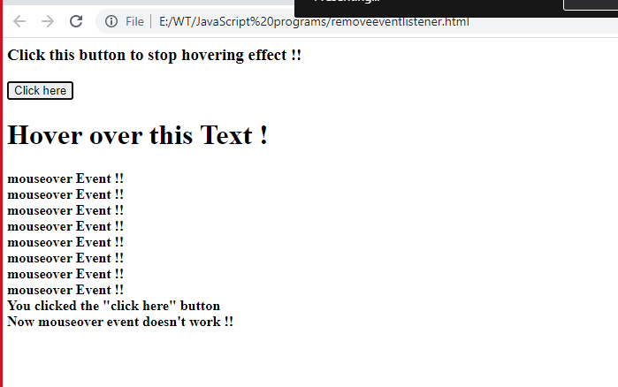

Slide 45
Bubbling Phase
When an event happens on an element, it first runs the handlers on it, then on its parent, then all the way up on other ancestors.
Ex”:
Let’s say we have 3 nested elements FORM > DIV > P with a handler on each of them:
So if we click on <p>, then we’ll see 3 alerts: p → div → form.
The process is called “bubbling”, because events “bubble” from the inner element up through parents like a bubble in the water.

Slide 46
Capturing Phase
The standard DOM Events describes 3 phases of event propagation:
1.Capturing phase – the event goes down to the element.
2.Target phase – the event reached the target element.
3. Bubbling phase – the event bubbles up from the element.

Slide 47
